Slide 1

Stock Price Prediction
By
Md Mahfuz Alam
(B.Tech 3rd Year, 12019002001019 )
Nitin Yadav
(B.Tech 3rd Year, 12019002001030 )
Under the Supervision of
Mrs Jyoti Khandelwal
Dept. of Computer Science & Engineering
University of Engineering & Management, Jaipur

Slide 2
Warning
Stock values are subjected to market risks
Please invest carefully

Slide 3
Outlines
Introduction
Literature Review
Objectives
Proposed Model
Experimental Setup
Result Analysis
Conclusion & Future Scope
Reference
Acknowledgement

Slide 4
Introduction
Trading is the process of buying and selling of financial instruments
One of the most important sources for commpanies to raise money allows businesses to go public, or raise additional capital for expansion

Slide 5
Literature Review
Predicting stock performance is a very large and profitable area of study
Many companies have developed stock predictors based on neural networks
Can give an edge to beginning investors who don’t have a lifetime of experience
This technique has proven successful in aiding the decisions of investors
Can give an edge to beginning investors who don’t have a lifetime of experience

Slide 6
Objectives
Collect a real time data extracted from yahoo finance .
Using the data perform prediction, we will predict the stock of the companies according to user input.

Slide 7
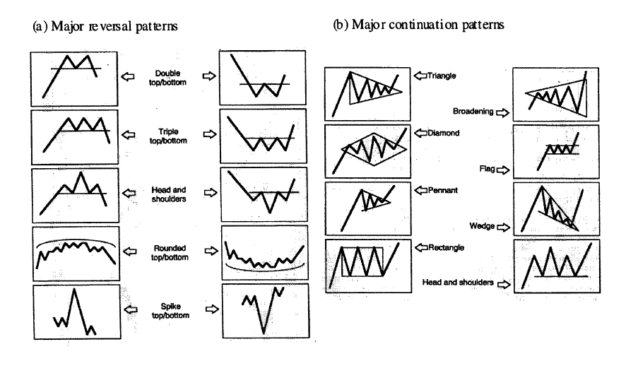
Motivation
Stock Prediction is more or less like Pattern Recognition
NN is a power tool for Pattern Regnition

Slide 8
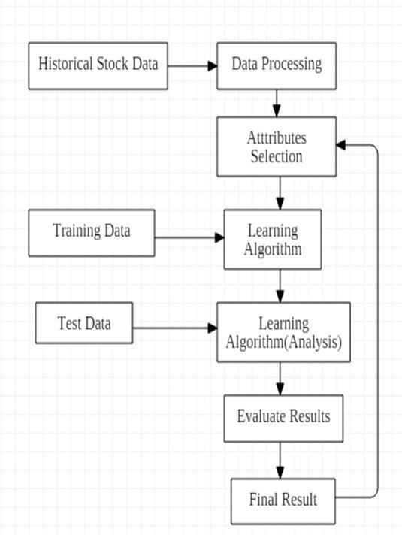
Proposed Model

Slide 9
Experimental Setup
Visual Studio Code
JUPYTER Notebook

Slide 10
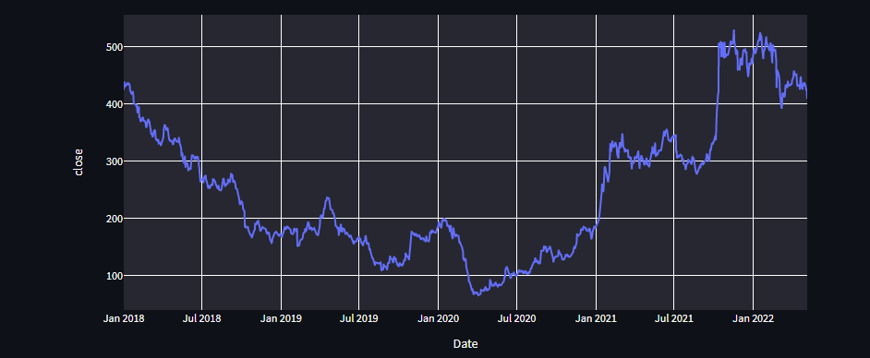
Result Analysis
https://stocks22.herokuapp.com/
Some test results of TATA MOTORS Stock
→ Closing Price Vs Time

Slide 11
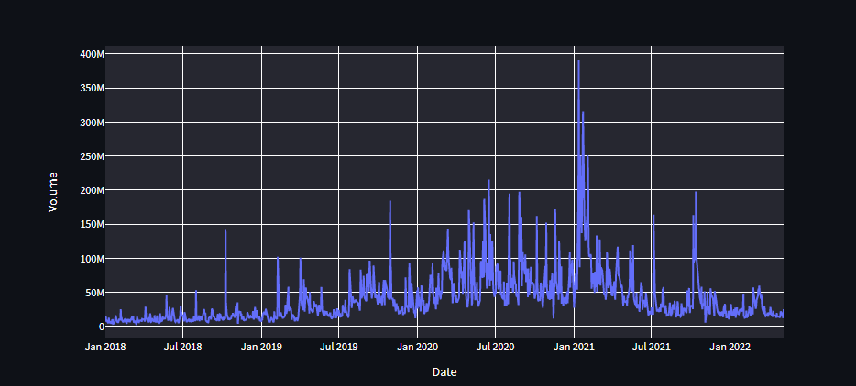
Volume vs Time

Slide 12
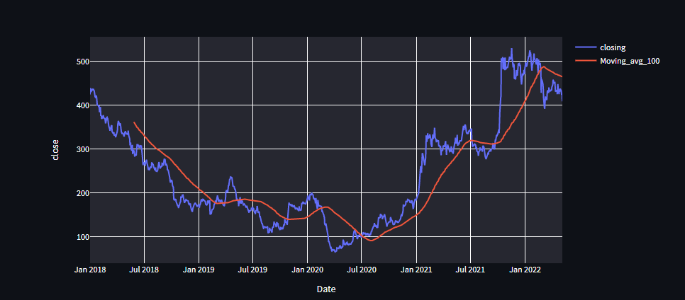
100 days Moving Average

Slide 13
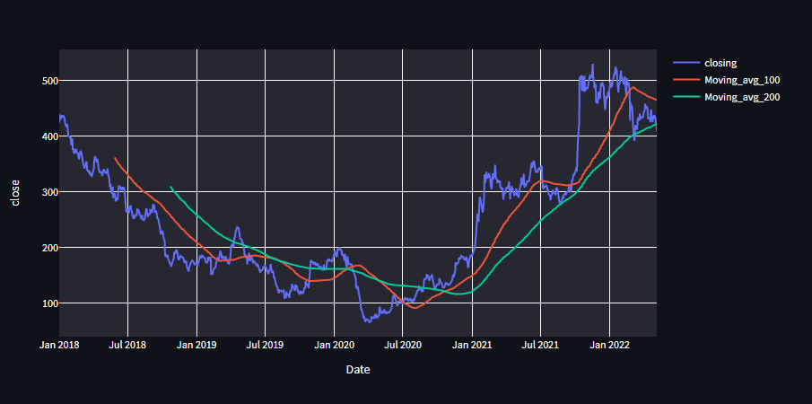
200 days Moving Average

Slide 14
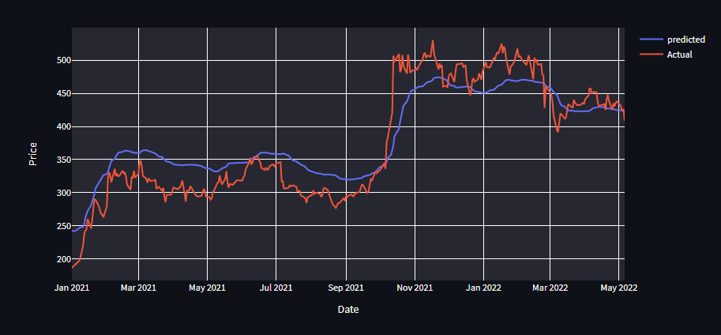
Predicted Vs Actual

Slide 15
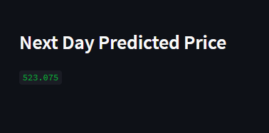
Next day Prediction

Slide 16
Conclusions & Future Scope
Able to consider a “lifetime” worth of data when making a prediction
Completely unbiased
95% Accuracy.
Under “normal” conditions, in most cases, our model will outperform most other current stock market predictors and be a very worthwhile, and potentially profitable aid to investors

Slide 17
Limitation
This system have many drawbacks including
As the predicted value is fully relying on data or past values
No way to predict unexpected factors, i.e. natural disaster, legal problems, etc.
No human or computer can perfectly predict the volatile stock market

Slide 18
Reference
GeekForGeeks:- https://www.geeksforgeeks.org/

Slide 19
Acknowledgement
We would like to express our special gratitude to our mentor Ms Jyoti Khandelwal for her guidance and support in completing our project. It was a great experience to work with our mentor Ms Jyoti Khandelwal. She guided us a lot during the project. She helps us in doing a lot research and we came to know about many things and we really thankful to her.
Secondly we would like to thank our group members who helped us a lot in finalizing this project within the limited time frame.

Slide 20

Dept. of CSE, University of Engineering & Management Jaipur

